Slide 1
Subject: | Language
GRADE | 3
TERM | 2

Slide 2
INSECTS | LISTENING AND SPEAKING
LIFE CYCLE | PHONICS
RECYCLING | READING AND VIEWING
KEEPING MY BODY SAFE | HANDWRITING

Slide 3
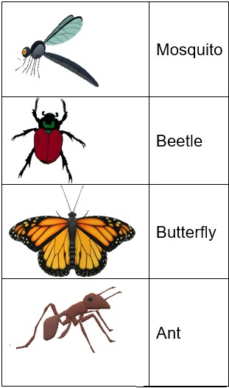
iNSECTS

Slide 4

INSECTS
Group 1

Slide 5
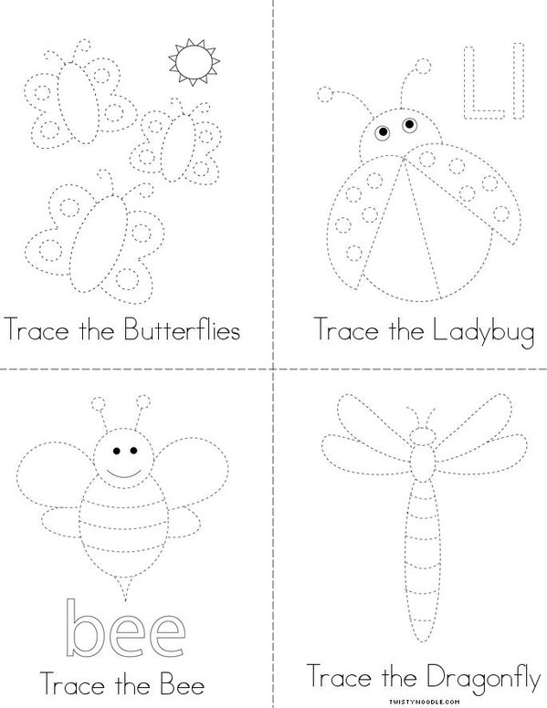
Insects

Slide 6
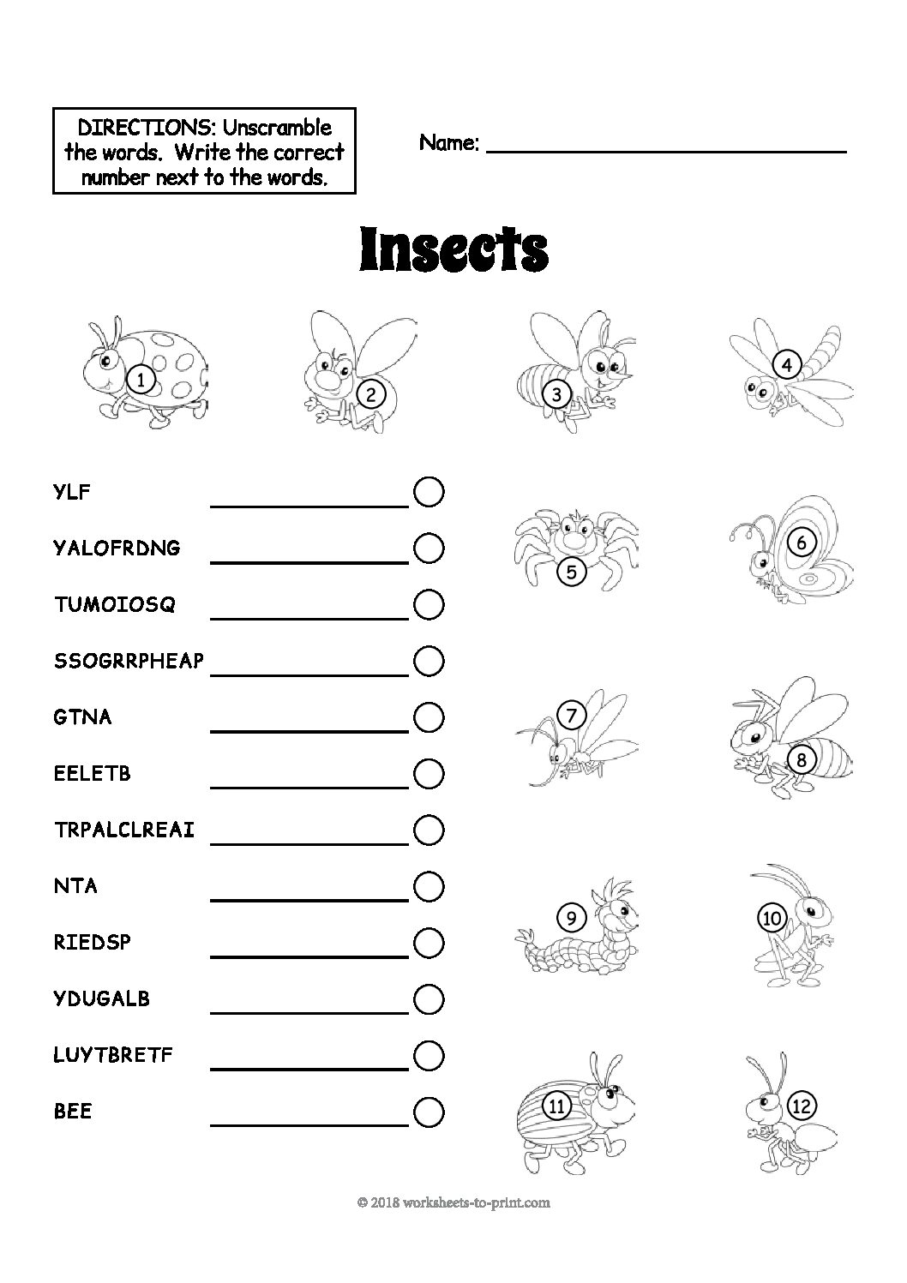
Insects
Group 2

Slide 7
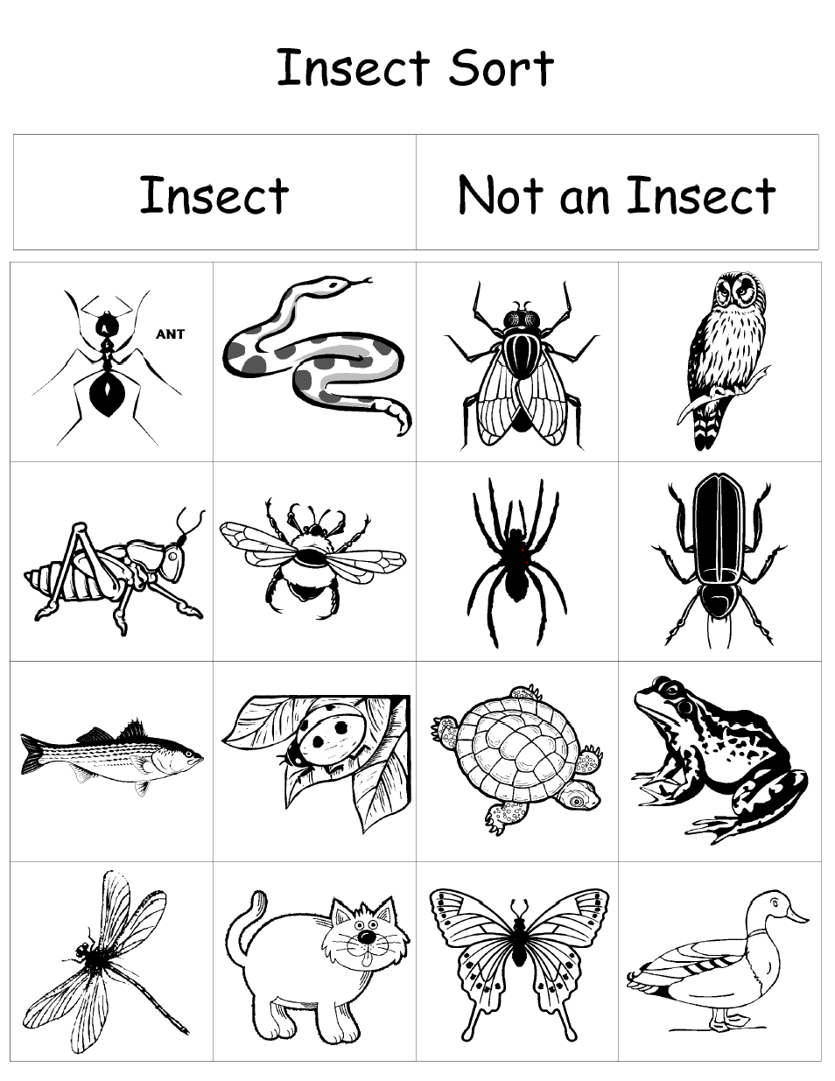
Insects

Slide 8
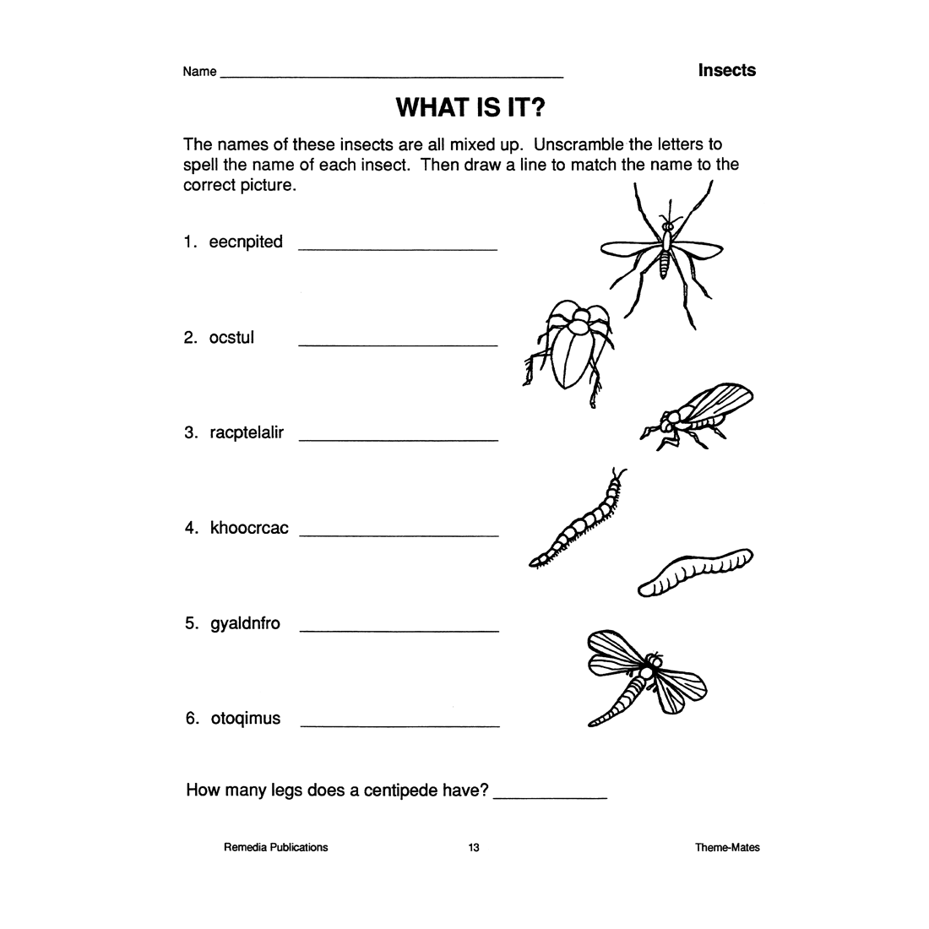
insects
Group 3

Slide 9
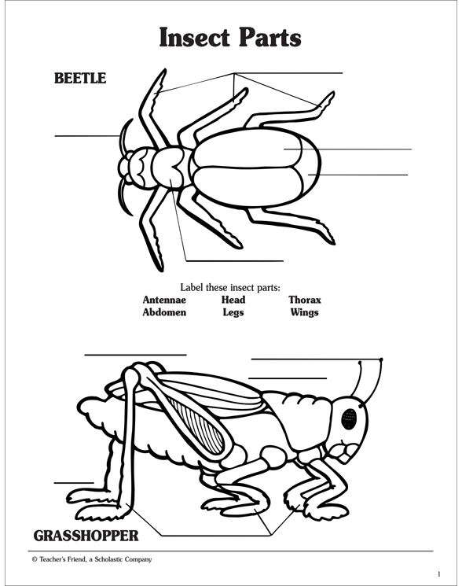
insects

Slide 10

Life cycle

Slide 11
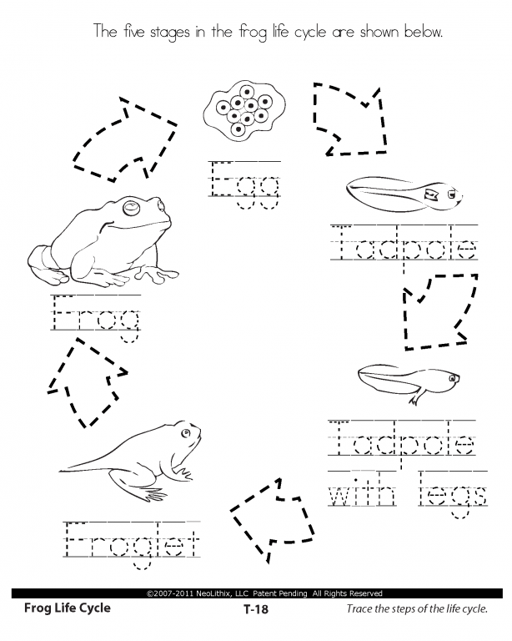
Life cycle
Group 1
Learners are required to trace the names of each stage below.

Slide 12
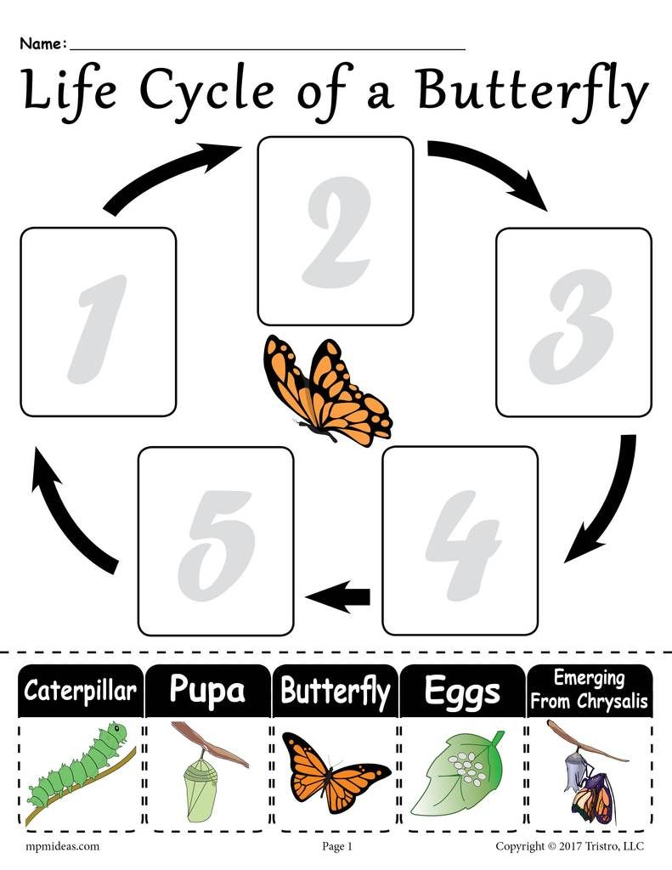
Life cycle

Slide 13
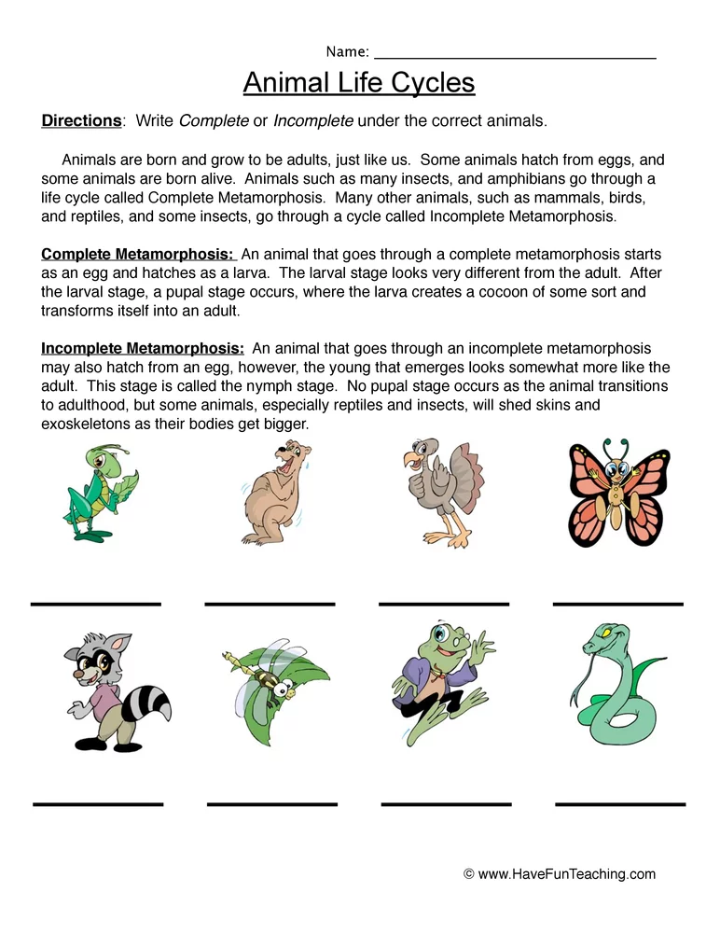
Life cycle
Group 2
Learners are required to highlight words that have the same end sound on this passage

Slide 14
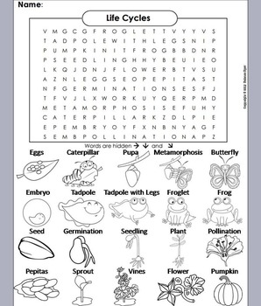
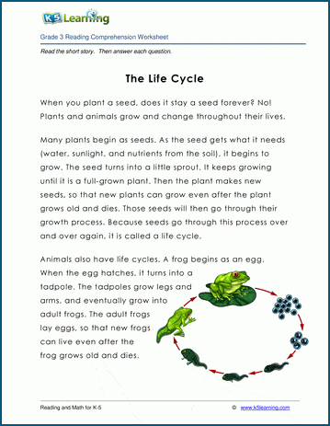
Life cycle

Slide 15
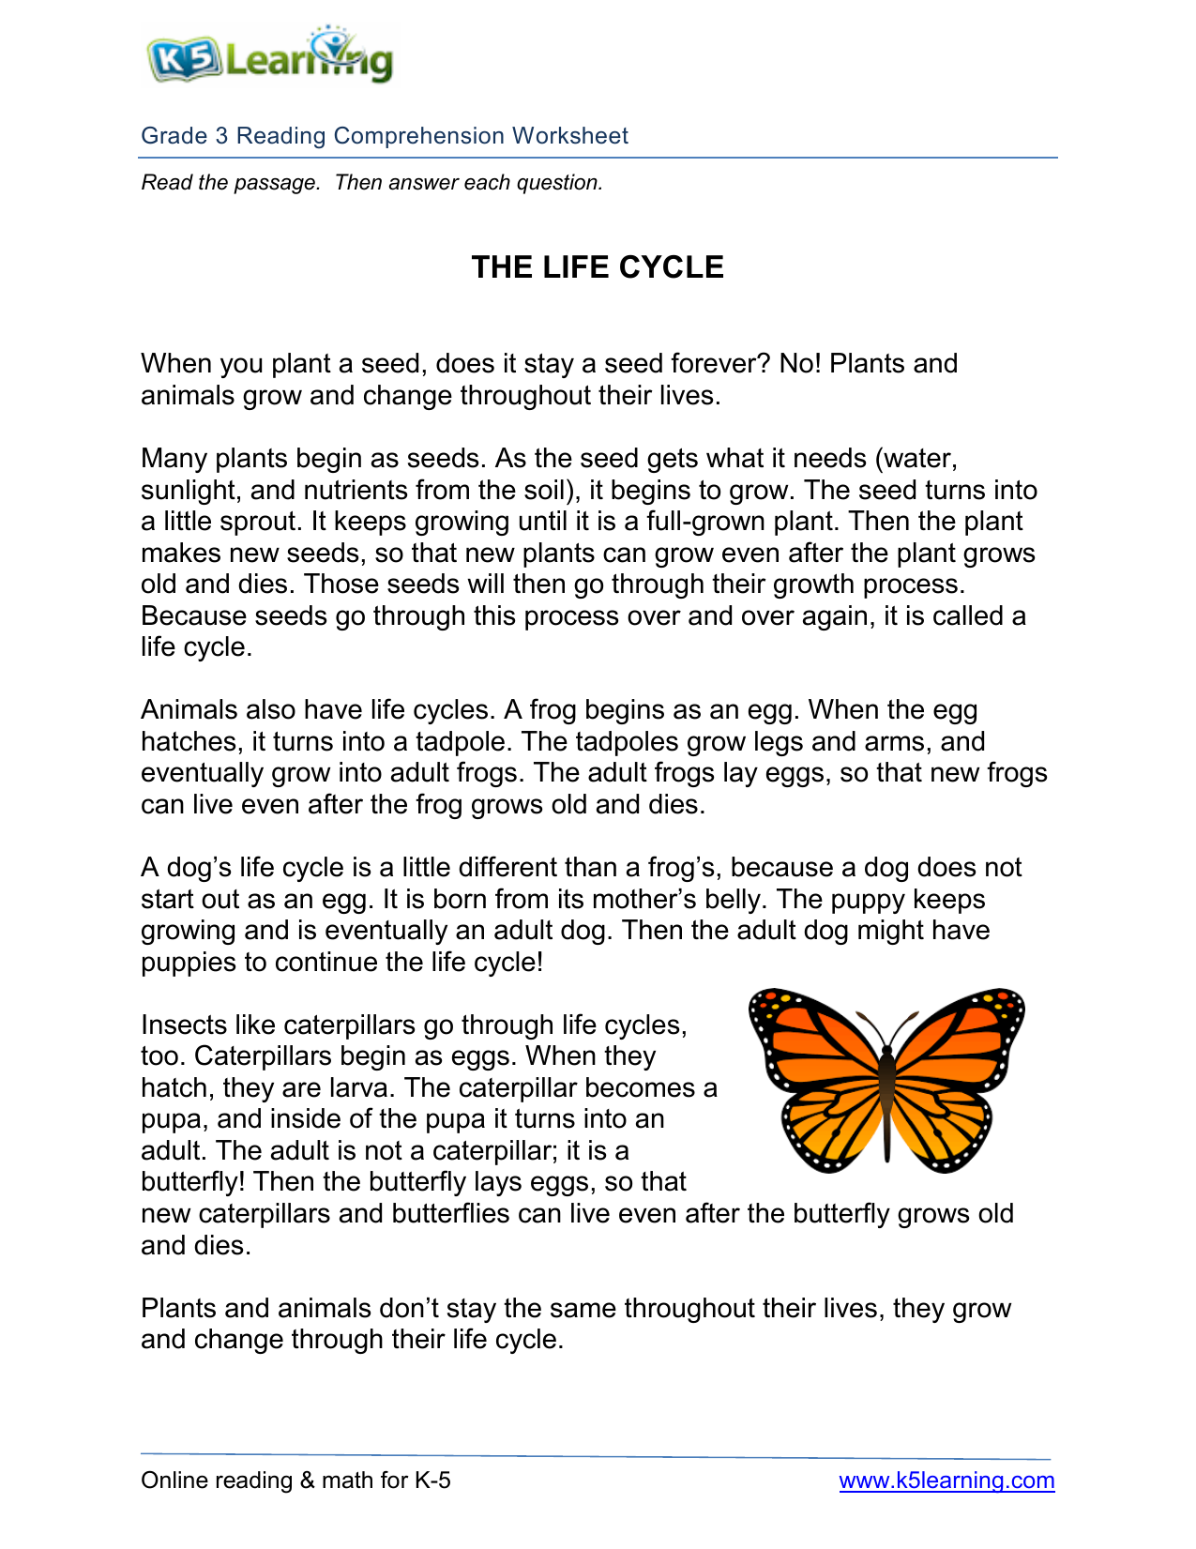
Life cycle
Group 3
Learners are required to identify and highlight rhyming words in this passage.

Slide 16
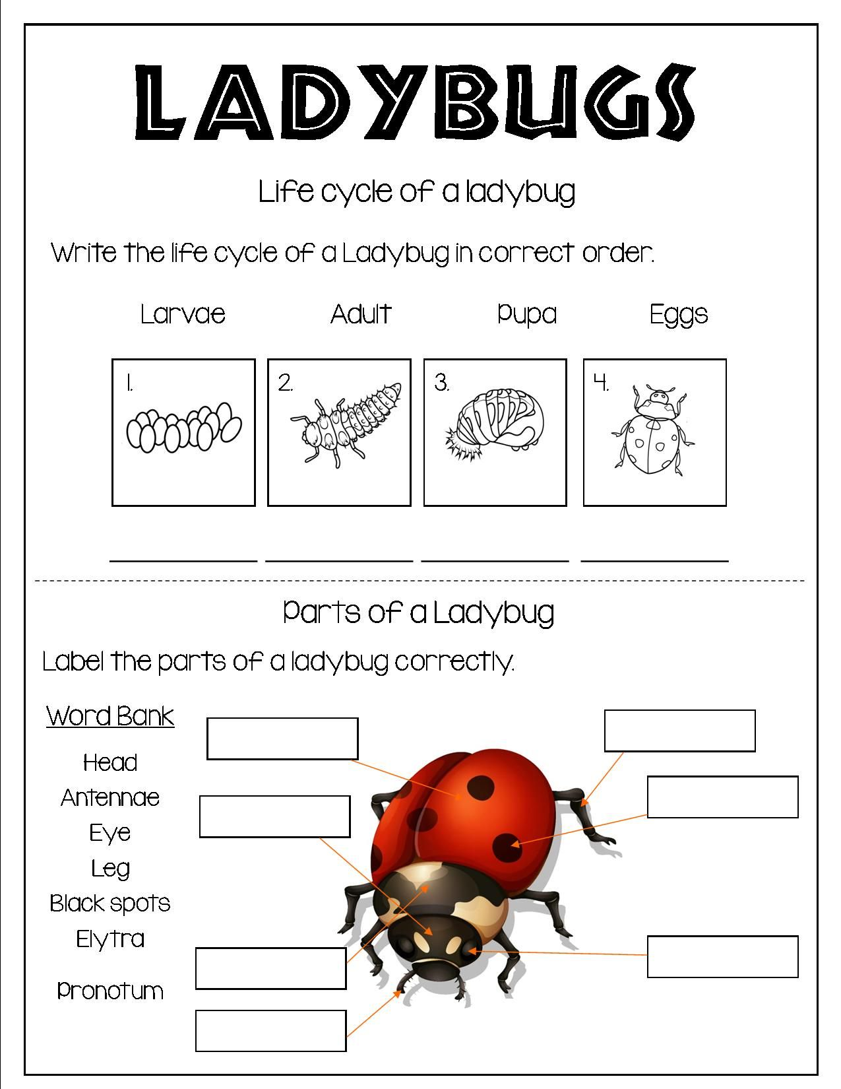
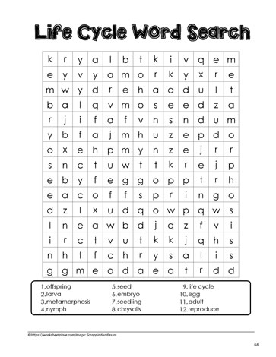
LIFE CYCLE

Slide 17

recycling

Slide 18
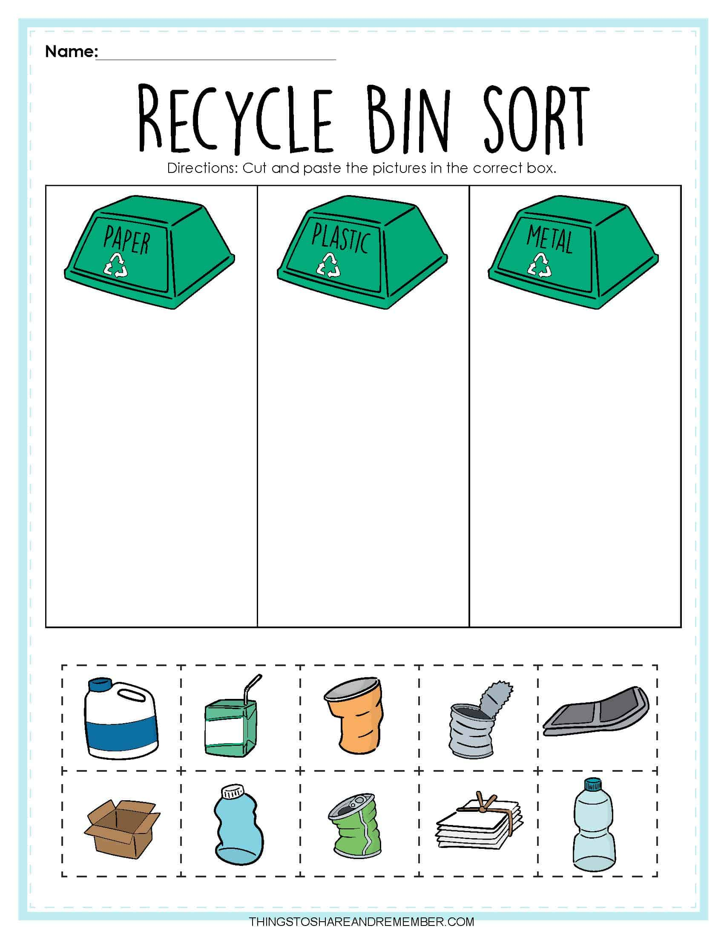
recycling
GROUP 1

Slide 19
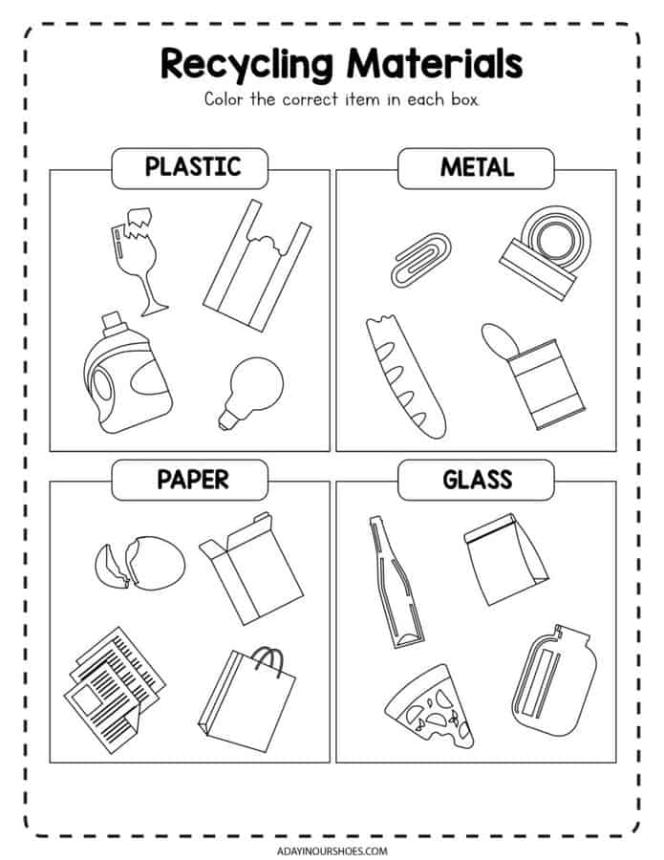
RECYCLING
Group 1

Slide 20
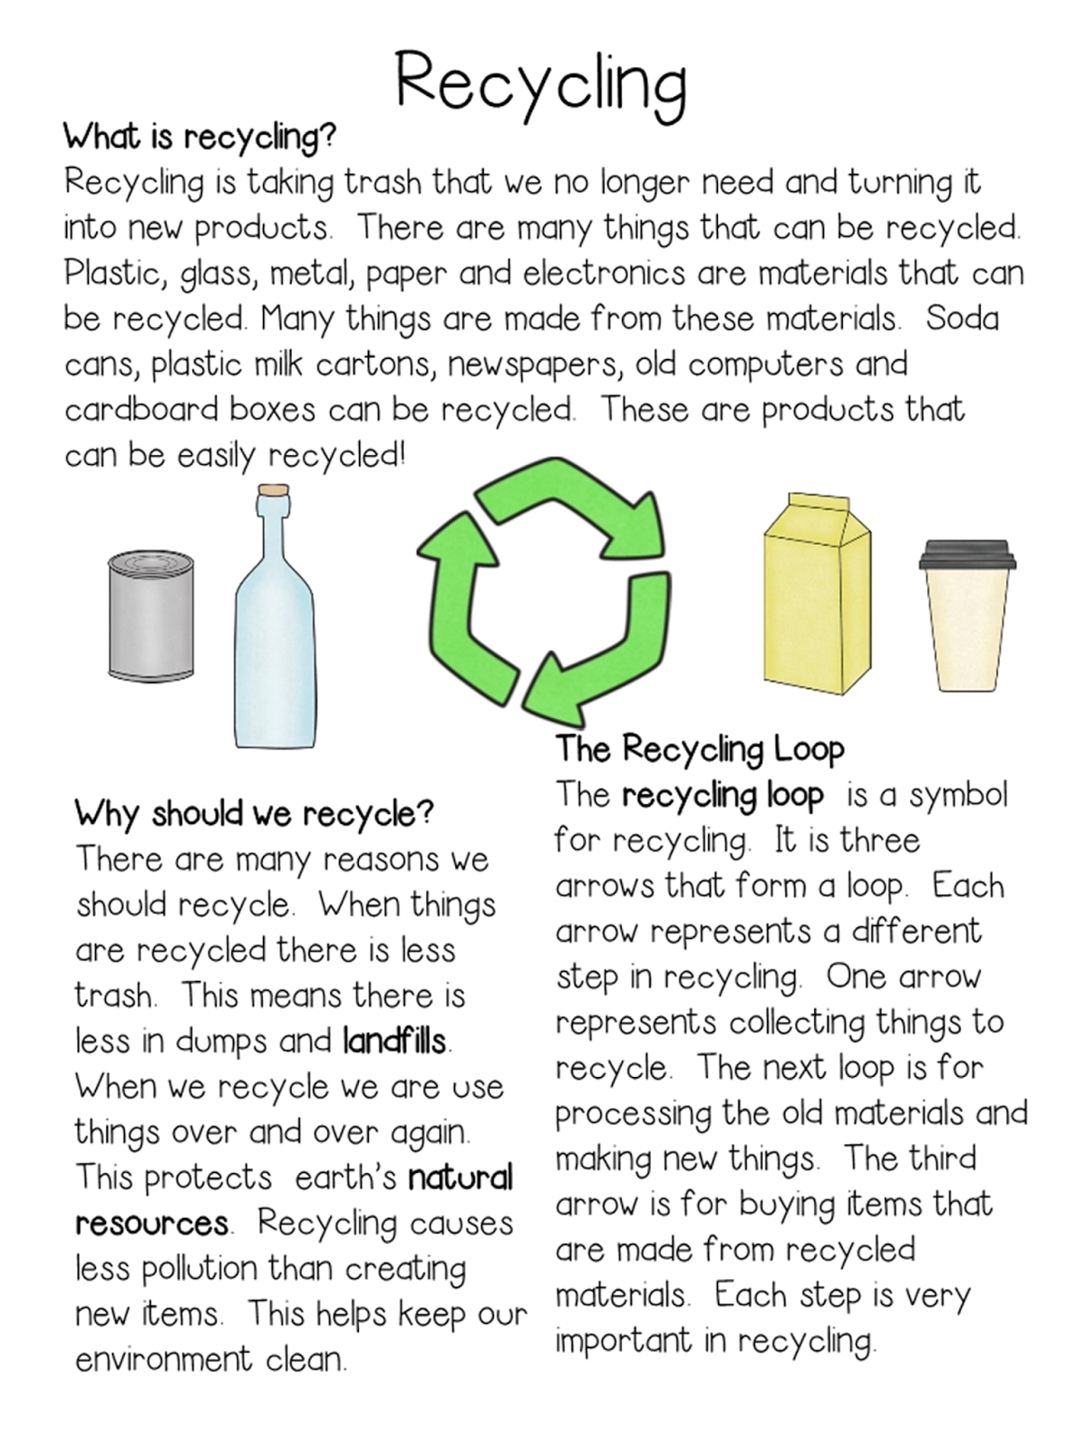
Life cycle
Group 2
Learners are required to Identify capital letters, full stop and question mark in the passage below.

Slide 21
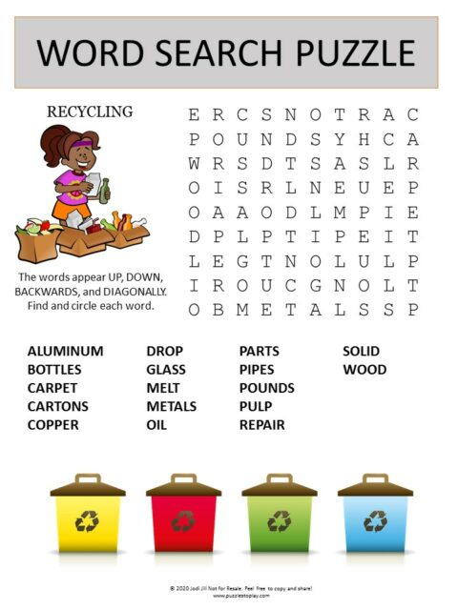
Life cycle
Group 2

Slide 22
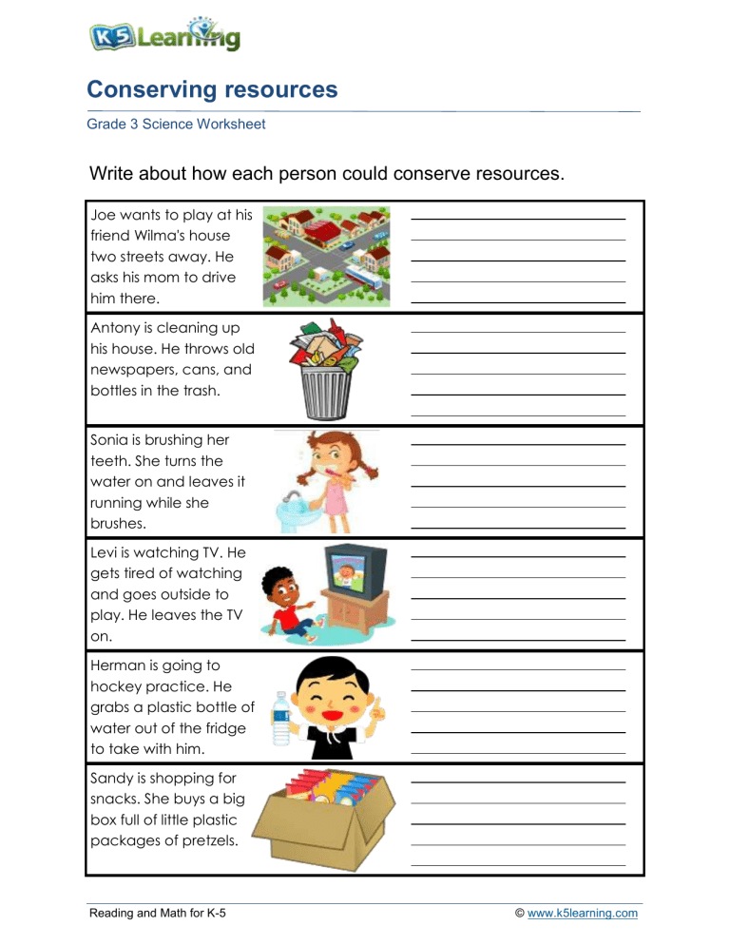
Life cycle
Group 3

Slide 23
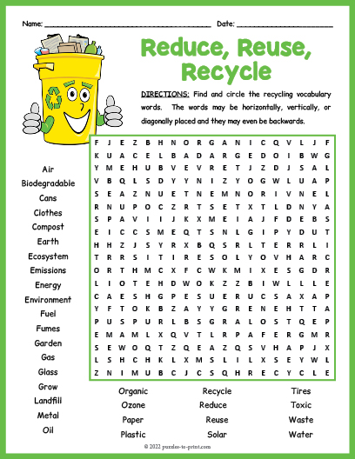
LIFE CYCLE
GROUP 3

Slide 24
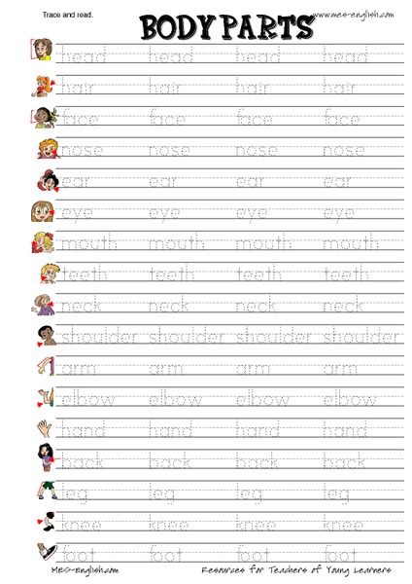
KEEPING MY BODY SAFE
Group 1

